Slide 1


Plasma based Integrated On-chip Antenna
Hasan T. Abbas and Robert D. Nevels
Dept. of ECEN, Texas A&M University, College Station, TX, USA
2016 IEEE International Symposium on Antennas and Propagation and North American Radio Science Meeting, Fajardo, Puerto Rico, Jun 26 - Jul 1 2016

Slide 2
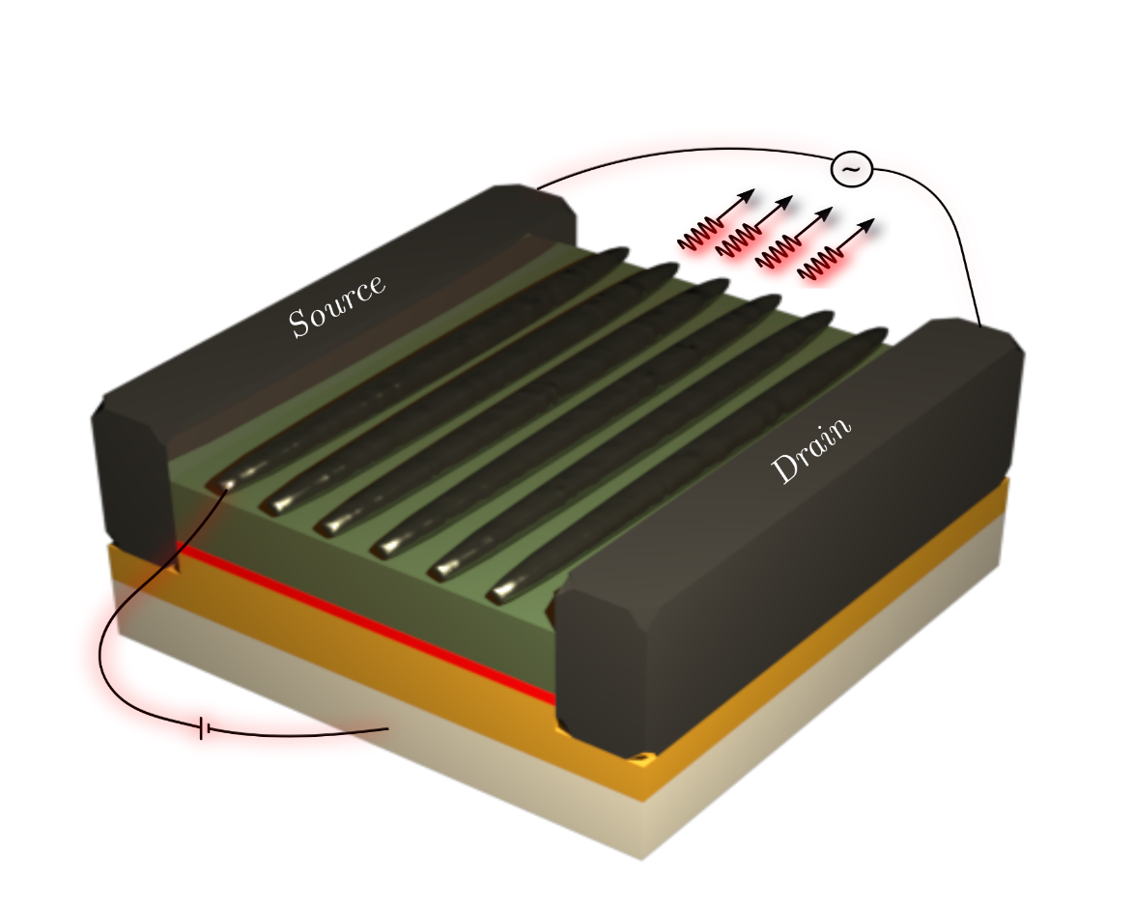
Outline
2D Plasmonic materials
Dyakonov-Shur Instability
Radiative Emission
Radiation Detection
Thermal Effects
Directivity Enhancement
Current state-of-the-art
Comparison with Graphene

Slide 3
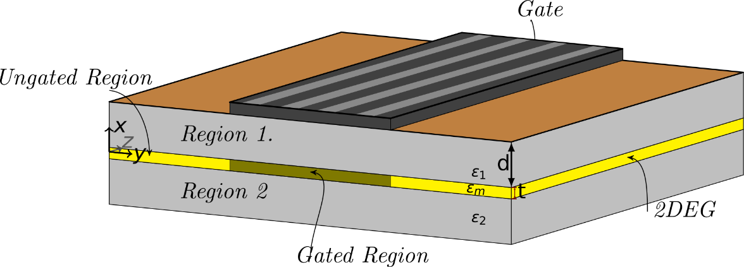
Terahertz Plasmons
Bulk
Semiconductor Substrates
No dispersion at terahertz or microwave frequencies
2D Electron Gas
Semiconductor heterostructures and graphene
Extreme sub-wavelength confinement
Reduced circuit dimensions
e: Electron Charge
N: Electron Charge Density
m*: effective mass of electron
ε: permittivity of the medium
d: top substrate layer thickness
Notes:
Owing to the difficulties in engineering Graphene in bulk and the its high cost, we focus on the 2DEG found in semiconductor heterojunction that are formed naturally in the fabrication process.

Slide 4
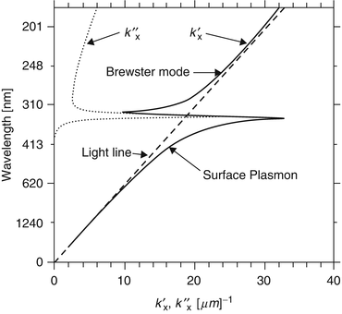
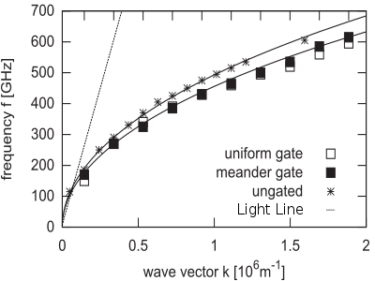
Metal vs Semiconductor Plasmonics
Surface Plasmon Dispersion Diagram for Silver/Air interface at Optical frequency
2DEG Plasmon Dispersion Diagram at Terahertz Frequency
Nevels, R. and Abbas, H. “Optical Nanoantennas,” in Handbook of Antenna Technologies, Springer Singapore pp. 1-33, (2015)
Białek, M. and Czapkiewicz, M. and Wróbel, J. and Umansky, V. and Łusakowski, J. “Plasmon dispersions in high electron mobility terahertz detectors,” in Applied Physics Letters, 104, 263514 (2014), DOI:http://dx.doi.org/10.1063/1.4886970.
Notes:
Owing to the difficulties in engineering Graphene in bulk and the its high cost, we focus on the 2DEG found in semiconductor heterojunction that are formed naturally in the fabrication process.

Slide 5
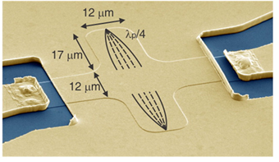
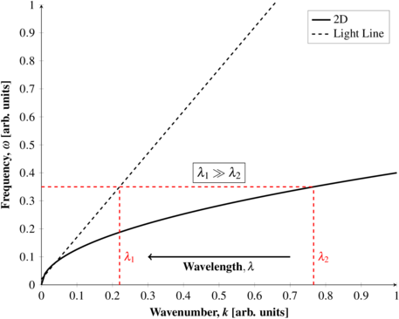
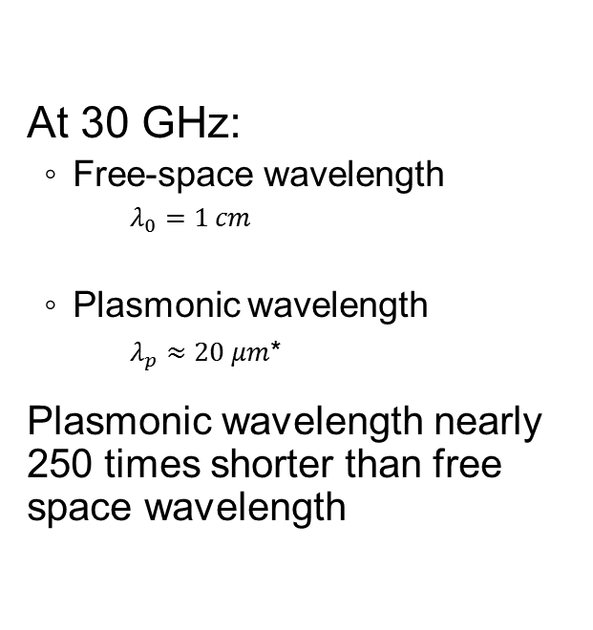
2D Plasmon Wavelength Reduction
At 30 GHz:
Free-space wavelength
$$λ_{0}=1 cm$$
Plasmonic wavelength
$λ_{p}≈20 μm$*
Plasmonic wavelength nearly 250 times shorter than free space wavelength
*Andress, W. A. et al., “Ultra-Subwavelength Two-Dimensional Plasmonic Circuits,” in Nano Letters vol. 12 no. 5, pp. 2272-2277, 2012.
Notes:
Owing to the difficulties in engineering Graphene in bulk and the its high cost, we focus on the 2DEG found in semiconductor heterojunction that are formed naturally in the fabrication process.

Slide 6
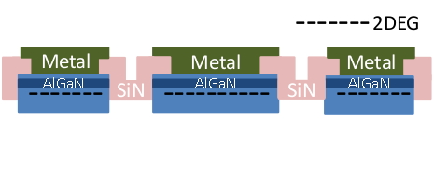
The 2DEG plasmon
Semiconductor Heterostructure
2 Dimensional Electron Gas (2DEG) formed at the heterojunction
Junction materials have different bandgaps
GaN/AlGaN and GaAs/AlGaAs commonly used
High Electron Mobility Transistor (HEMT) incorporates 2DEG as a channel
With contemporary HEMT dimensions, plasma waves are generated in the low terahertz region.

Slide 7
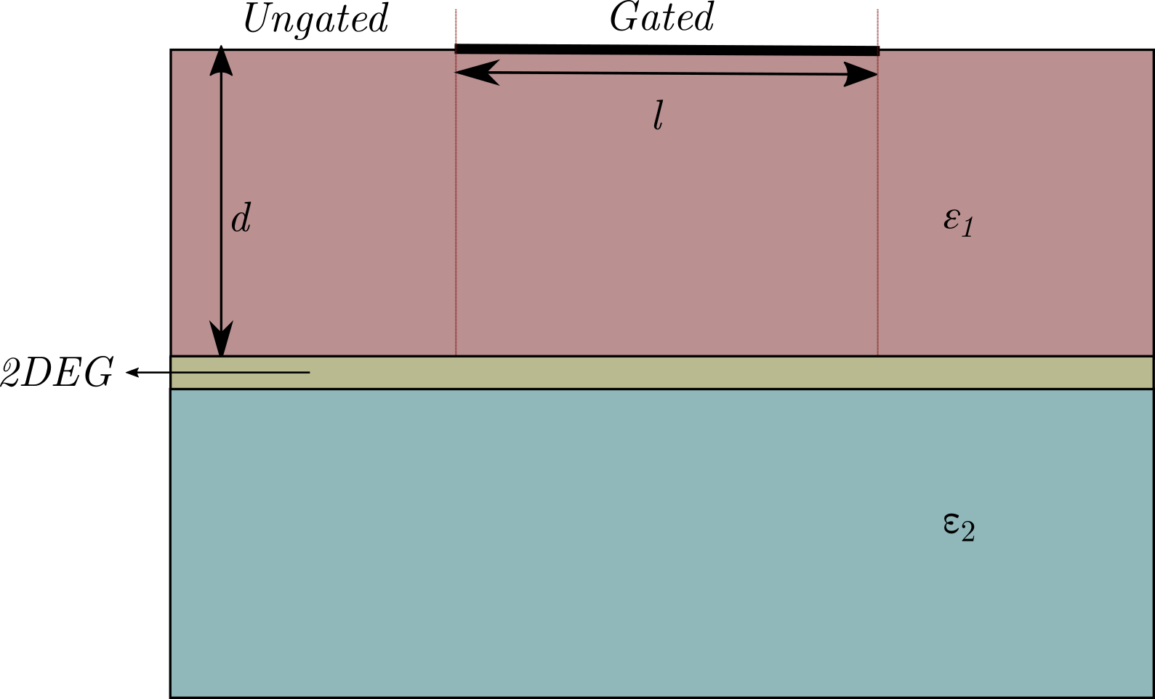
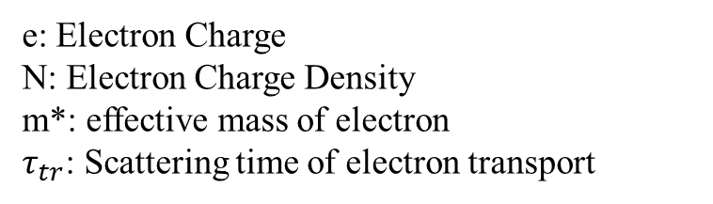
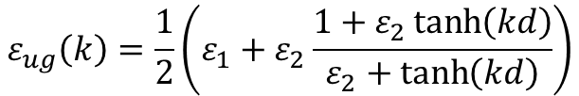


2DEG Characterization
Dielectric Constant
Gated Region
Ungated Region
Conductivity
$σ\left(ω\right)=\frac{N e^{2}τ_{tr}}{m^{∗}}\frac{1}{1+jωτ_{tr}}$
$$ε_{g}\left(k\right)=\frac{1}{2}\left(ε_{1}+ε_{2}\coth\left(kd\right)\right)$$
$$ε_{ug}\left(k\right)=\frac{1}{2}\left(ε_{1}+ε_{2}\frac{1+ε_{2}\tanh\left(kd\right)}{ε_{2}+\tanh\left(kd\right)}\right)$$
e: Electron Charge
N: Electron Charge Density
m*: effective mass of electron
$τ_{tr}$: Scattering time of electron transport

Slide 8


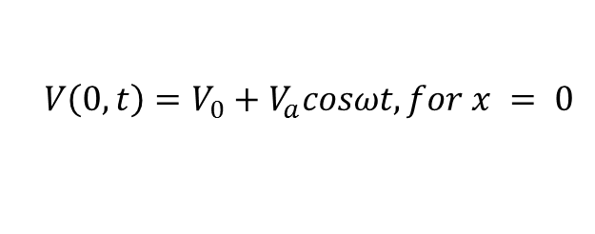

Dyakonov-Shur Instability
Transistor channel can become unstable when properly biased
Asymmetric boundary conditions on the channel (source – short circuited, drain – open circuited) lead to laser-like phenomena
Resonant amplification of plasma waves in the 2DEG leads to radiative emission
$$\frac{∂V}{∂t}+\frac{∂\left(V v\right)}{∂x}=0$$
V: Voltage
v: Electron velocity
J: Current Density
L: channel length
$$V\left.\left(0,t\right.\right)=V_{0}+V_{a}cosωt, for x = 0$$
$$J\left( L,t\right)=0, for x = L$$
Notes:
Electron flow in a 2DEG is of ballistic nature. Means, the flow (or the current) starts to shoot in the saturation region.

Slide 9
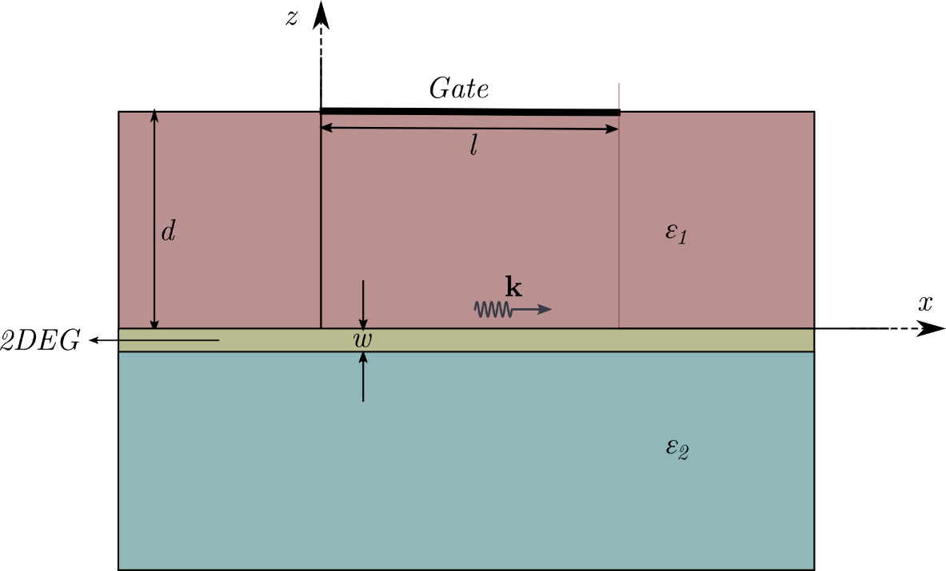







2DEG: Transmission Line Model
Plasma Oscillations described by the hydrodynamic model
$$\frac{∂V_{ω}\left(x,t\right)}{∂x}=−L \frac{∂I_{ω}\left(x,t\right)}{∂t} −RI_{ω}\left(x,t\right)$$
$$\frac{∂I_{ω}\left(x,t\right)}{∂x}=−C(ω) \frac{∂V_{ω}\left(x,t\right)}{∂t}$$
$$R=\frac{m^{∗}}{e^{2}N τw}$$
$$L=\frac{m^{∗}}{e^{2}N w}$$
$$C\left(ω\right)=Re\left[\frac{wε_{eff}k\left(1+\coth{kd}\right)}{4π}\right]$$
$$G\left(ω\right)=−ω Im\left[\frac{wε_{eff}k\left(1+\coth{kd}\right)}{4π}\right]$$
k: Complex wavenumber
N: Electron Charge Density
𝜀_{𝑒𝑓𝑓}: (𝜀₁ + 𝜀₂)/2
m*: effective mass of electron
$τ$: Scattering time of electron transport
w: Thickness of 2DEG
Notes:
Electron flow in a 2DEG is of ballistic nature. Means, the flow (or the current) starts to shoot in the saturation region.

Slide 10
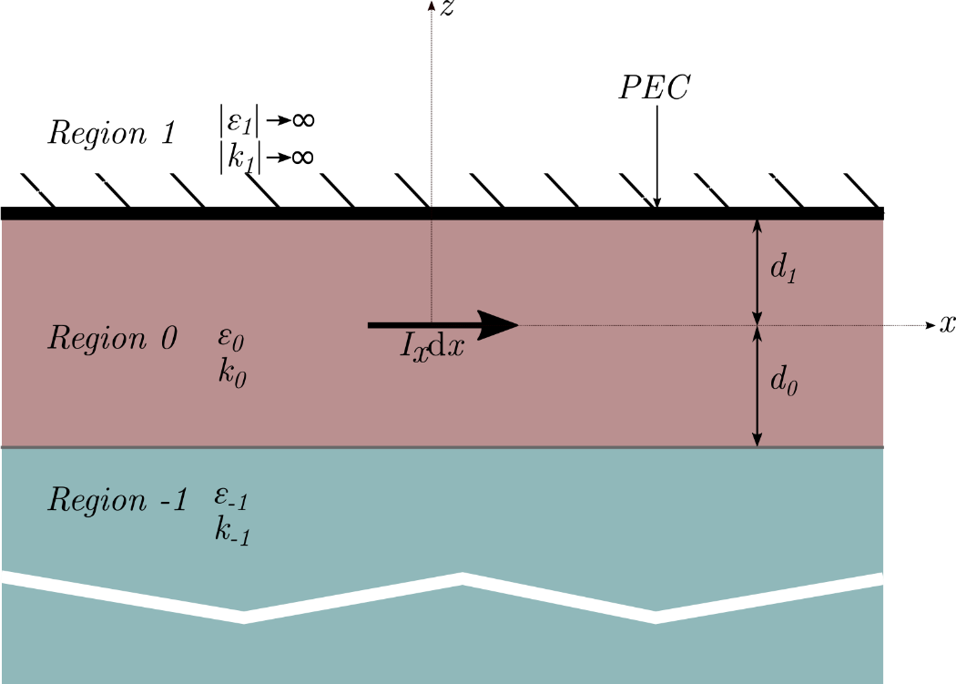




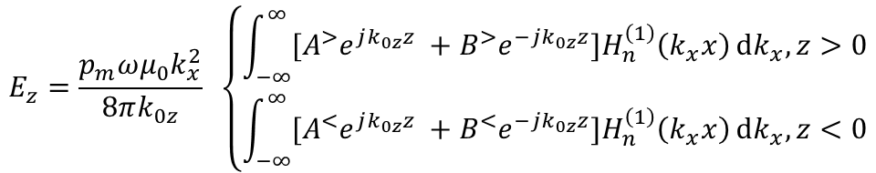



Field Integral (TM): Gated Region
For a magnetic dipole source, in region 0:
where,
$$E_{z}=\frac{p_{m}ωμ_{0}k_{x}^{2}}{8πk_{0z}} \left\{\begin{aligned}\int_{−∞}^{∞}{{[A}^{>}e^{jk_{0z}z} +B^{>}e^{−jk_{0z}z}]H_{n}^{\left(1\right)}\left(k_{x}x\right)ⅆk_{x}, z>0} \\ \int_{−∞}^{∞}{{[A}^{<}e^{jk_{0z}z} +B^{<}e^{−jk_{0z}z}]H_{n}^{\left(1\right)}\left(k_{x}x\right)ⅆk_{x}, z<0}\end{aligned}\right.$$
$$A^{>}=\frac{1+R^{↓}}{1− R^{↑}R^{↓}}\text{,}$$
$$B^{>}=R^{↑}\frac{1+R^{↓}}{1− R^{↑}R^{↓}}$$
$$A^{<}=R^{↓}\frac{1+R^{↑}}{1− R^{↑}R^{↓}}\text{,}$$
$$B^{<}=\frac{1+R^{↑}}{1− R^{↑}R^{↓}}$$
$$R^{↑}=−e^{j2k_{0z}z d_{1}}$$
$$R^{↓}=e^{−j2k_{0z}z d_{0}}\frac{ε_{−1}k_{0z} −ε_{0}k_{−1z}}{ε_{−1}k_{0z}+ε_{0}k_{−1z} }$$
$$k_{iz}=\sqrt{k_{i}^{2} −k_{x}^{2}}$$
p_{m} : Magnetic Dipole moment
Notes:
Electron flow in a 2DEG is of ballistic nature. Means, the flow (or the current) starts to shoot in the saturation region.

Slide 11
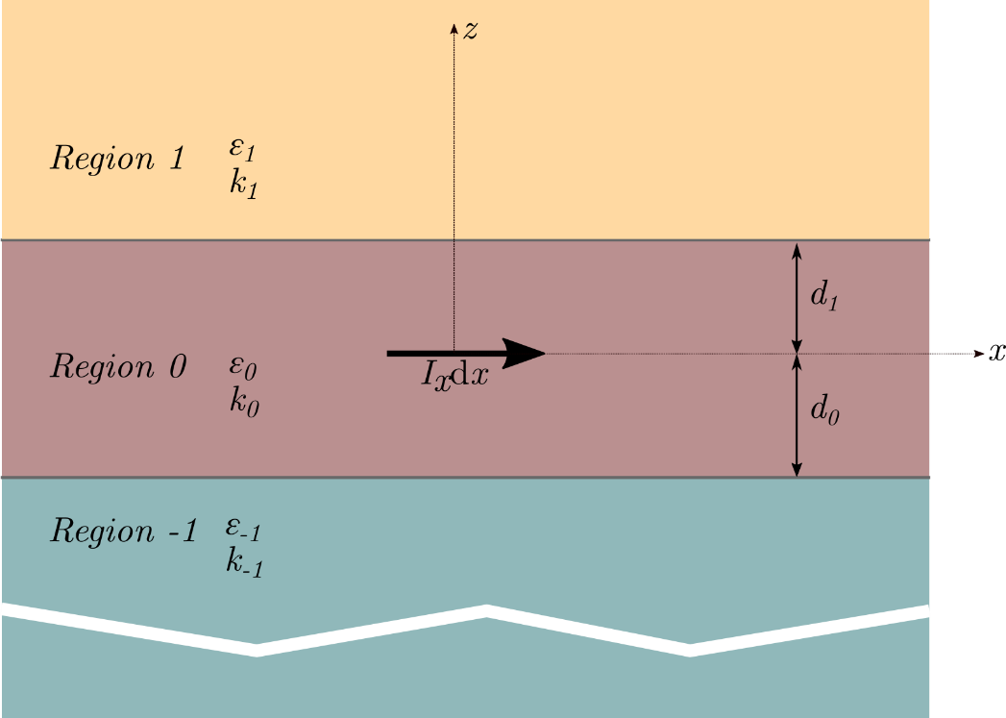



Field Integral (TM): Ungated Region
For a magnetic dipole source, in region 0:
where,
$$E_{z}=\frac{p_{m}ωμ_{0}k_{x}^{2}}{8πk_{0z}} \left\{\begin{aligned}\int_{−∞}^{∞}{{[A}^{>}e^{jk_{0z}z} +B^{>}e^{−jk_{0z}z}]H_{n}^{\left(1\right)}\left(k_{x}x\right)ⅆk_{x}, z>0} \\ \int_{−∞}^{∞}{{[A}^{<}e^{jk_{0z}z} +B^{<}e^{−jk_{0z}z}]H_{n}^{\left(1\right)}\left(k_{x}x\right)ⅆk_{x}, z<0}\end{aligned}\right.$$
$$A^{>}=\frac{1+R^{↓}}{1− R^{↑}R^{↓}}\text{,}$$
$$B^{>}=R^{↑}\frac{1+R^{↓}}{1− R^{↑}R^{↓}}$$
$$A^{<}=R^{↓}\frac{1+R^{↑}}{1− R^{↑}R^{↓}}\text{,}$$
$$B^{<}=\frac{1+R^{↑}}{1− R^{↑}R^{↓}}$$
$$R^{↑}=e^{j2k_{0z}z d_{1}}\frac{ε_{1}k_{0z} −ε_{0}k_{1z}}{ε_{1}k_{0z}+ε_{0}k_{1z} }$$
$$R^{↓}=e^{−j2k_{0z}z d_{0}}\frac{ε_{−1}k_{0z} −ε_{0}k_{−1z}}{ε_{−1}k_{0z}+ε_{0}k_{−1z} }$$
$$k_{iz}=\sqrt{k_{i}^{2} −k_{x}^{2}}$$
p_{m} : Magnetic Dipole moment
Notes:
Electron flow in a 2DEG is of ballistic nature. Means, the flow (or the current) starts to shoot in the saturation region.

Slide 12
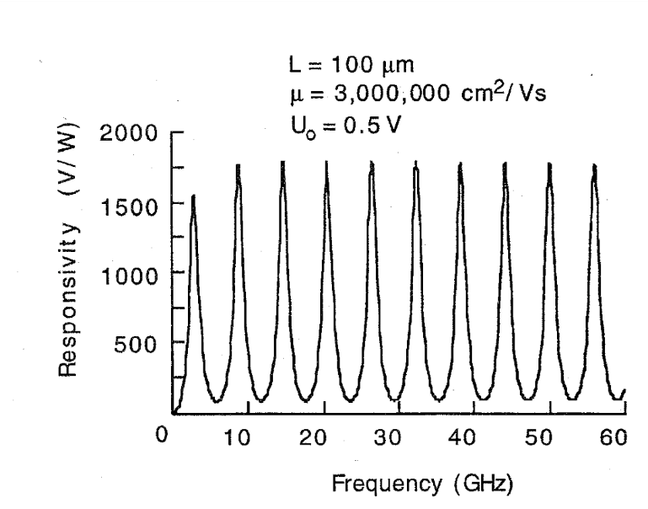
Radiation Sensing
Incident electromagnetic waves couple with the 2DEG plasma waves
Enhanced plasma oscillations induce a dc voltage across the drain and source terminals.
The detector response displays a modal behavior
Dyakonov, M.; Shur, M., "Detection, mixing, and frequency multiplication of terahertz radiation by two-dimensional electronic fluid," in Electron Devices, IEEE Transactions on , vol.43, no.3, pp.380-387, Mar 1996

Slide 13
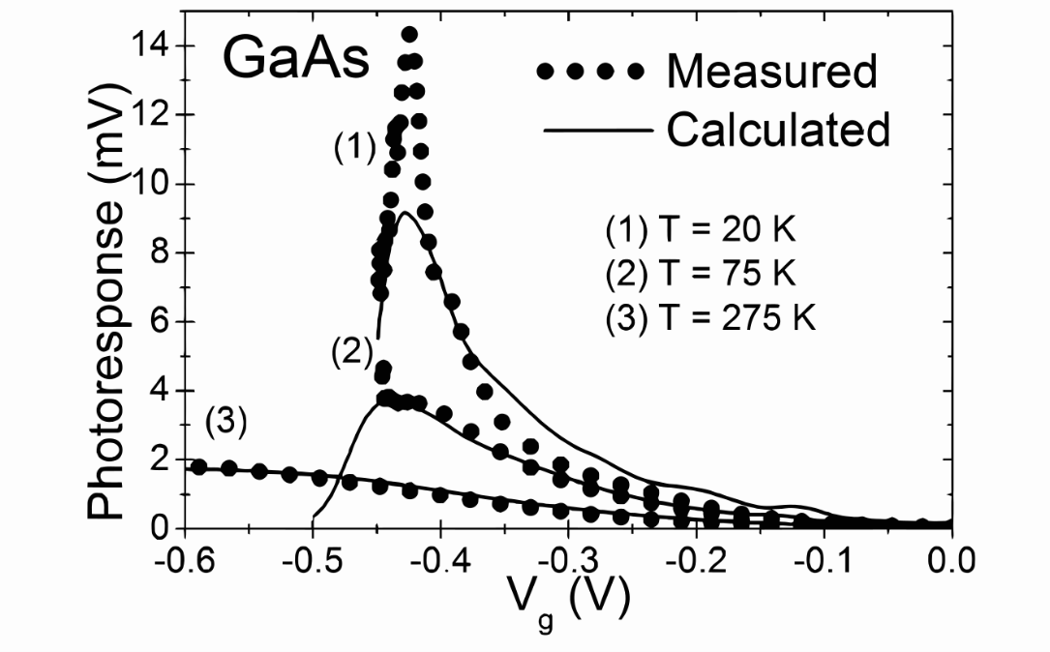
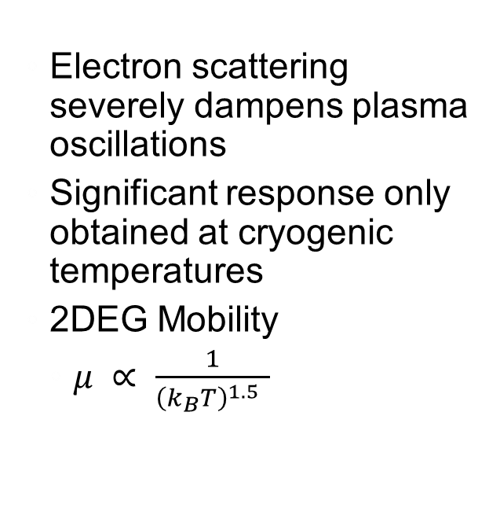
Thermal Effects
Electron scattering severely dampens plasma oscillations
Significant response only obtained at cryogenic temperatures
2DEG Mobility
$μ ∝ \frac{1}{{\left(k_{B}T\right)}^{1.5} }$
Klimenko, O. A. et al., “Temperature enhancement of terahertz responsivity of plasma field effect transistors,” in Journal of Applied Physics,112, 014506 , 2012.

Slide 14

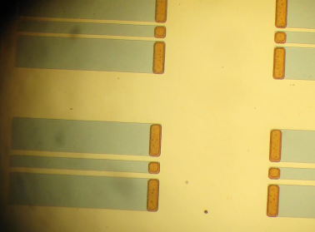
Plasmonic Microwave Devices
Similar to Surface Plasmon Polaritons (SPP) in the optical domain, 2D plasmons assist in extreme subwavelength confinement
Miniaturization of transmission lines and antenna
Cryogenic Temperature operation
Andress, W. A. et al., “Ultra-Subwavelength Two-Dimensional Plasmonic Circuits,” in Nano Letters vol. 12 no. 5, pp. 2272-2277, 2012.

Slide 15
Conclusion
Instability of resonant plasma waves in a 2DEG results in terahertz radiation
On-chip antenna in the terahertz region can be designed
Engineering of special materials displaying low loss at room temperatures required
Resonant wavelength in a 2DEG much shorter than a metal dipole counterpart
Antenna miniaturization

Slide 16
Questions?

